Slide 1


Web Security
Let’s continue to hack!

Slide 2



Alain Tiemblo
Web Security Lead Engineer @ BlaBlaCar
ninsuo

Slide 3
What’s up?

Slide 4

$81 million
cyber heist in Bangladesh Bank
02 2016
Notes:
Here is a snapshot of western europe at a specific time. Each one of these blue point is a car with people sharing a trip. In Berlin specifically tonight two cars will be leaving every minute from 270 different departing points.

Slide 5

Heist record is $69.8M
08 2005
Notes:
Here is a snapshot of western europe at a specific time. Each one of these blue point is a car with people sharing a trip. In Berlin specifically tonight two cars will be leaving every minute from 270 different departing points.

Slide 6
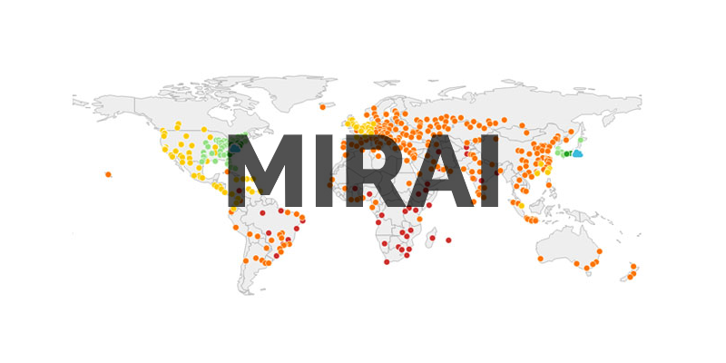
Mirai Botnet
09 2016
Notes:
Here is a snapshot of western europe at a specific time. Each one of these blue point is a car with people sharing a trip. In Berlin specifically tonight two cars will be leaving every minute from 270 different departing points.

Slide 7

Default passwords on 145K connected devices
Notes:
Here is a snapshot of western europe at a specific time. Each one of these blue point is a car with people sharing a trip. In Berlin specifically tonight two cars will be leaving every minute from 270 different departing points.

Slide 8
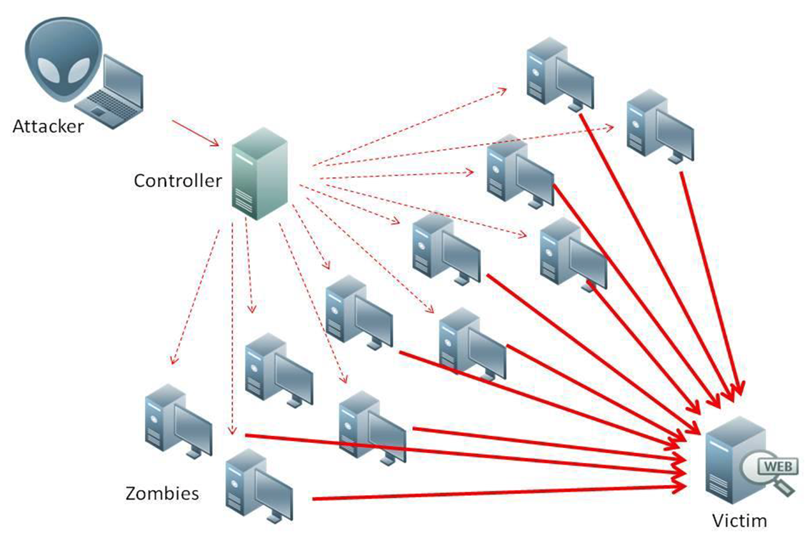
DDOS attacks at a 1TB/s rate
Notes:
Here is a snapshot of western europe at a specific time. Each one of these blue point is a car with people sharing a trip. In Berlin specifically tonight two cars will be leaving every minute from 270 different departing points.

Slide 9
DDOS prevention checklist
1
Set traffic thresholds based on the average number of visits you get
2
Create an IP blacklist and whitelist to be able to quickly respond to attacks over your applications
3
Automate communication with users with a service status application to avoid support 💩 storm
4
Hire an ops because as a backend developer, I can’t help you further here 😅

Slide 10


SHA-1 is proven broken
02 2017
Notes:
Here is a snapshot of western europe at a specific time. Each one of these blue point is a car with people sharing a trip. In Berlin specifically tonight two cars will be leaving every minute from 270 different departing points.

Slide 11



file1.pdf
file2.pdf
sha1 = 38762cf7f55934b34d179ae6a4c80cadccbb7f0a
Notes:
Here is a snapshot of western europe at a specific time. Each one of these blue point is a car with people sharing a trip. In Berlin specifically tonight two cars will be leaving every minute from 270 different departing points.

Slide 12
SHA-1 Checklist
1
Do not hash passwords using SHA-1, and if you did, bcrypt those hashes for more security
2
Do not use SHA-1 certificates, that’s no standard anymore since 2015
3
Do not use SHA-1 to check for data integrity, collisions are still hard to get but that’s doable
4
Use SHA-256 anywhere: in PHP, hash("sha256", $input)
Note that Google sunsetted SHA-1 on September, 2014

Slide 13

Major Data Leaks revealed!
2016
Notes:
Here is a snapshot of western europe at a specific time. Each one of these blue point is a car with people sharing a trip. In Berlin specifically tonight two cars will be leaving every minute from 270 different departing points.

Slide 14

93 338 602 accounts
Plain text passwords ❤️
Leaked in 2012
Notes:
Here is a snapshot of western europe at a specific time. Each one of these blue point is a car with people sharing a trip. In Berlin specifically tonight two cars will be leaving every minute from 270 different departing points.

Slide 15

112 005 531 accounts
MD5 passwords without salt
Leaked in 2016
Notes:
Here is a snapshot of western europe at a specific time. Each one of these blue point is a car with people sharing a trip. In Berlin specifically tonight two cars will be leaving every minute from 270 different departing points.

Slide 16

164 611 595 accounts
SHA-1 passwords without salt
Leaked in 2012
Notes:
Here is a snapshot of western europe at a specific time. Each one of these blue point is a car with people sharing a trip. In Berlin specifically tonight two cars will be leaving every minute from 270 different departing points.

Slide 17

234 842 089 accounts
Plain text passwords ❤️
Leaked in 2015
Notes:
Here is a snapshot of western europe at a specific time. Each one of these blue point is a car with people sharing a trip. In Berlin specifically tonight two cars will be leaving every minute from 270 different departing points.

Slide 18

359 420 698 accounts
SHA-1 passwords without salt
Leaked in 2008
Notes:
Here is a snapshot of western europe at a specific time. Each one of these blue point is a car with people sharing a trip. In Berlin specifically tonight two cars will be leaving every minute from 270 different departing points.

Slide 19

Use bcrypt to hash passwords!
Why the hell companies don’t use it!
Notes:
Here is a snapshot of western europe at a specific time. Each one of these blue point is a car with people sharing a trip. In Berlin specifically tonight two cars will be leaving every minute from 270 different departing points.

Slide 20
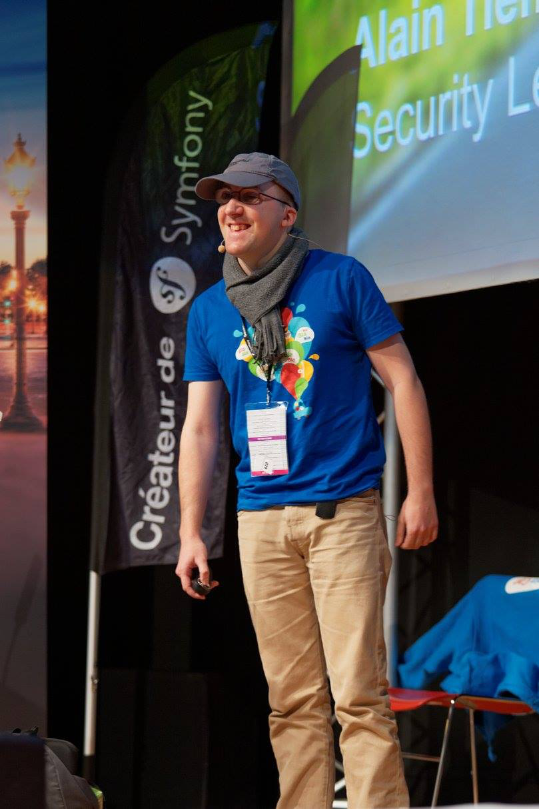
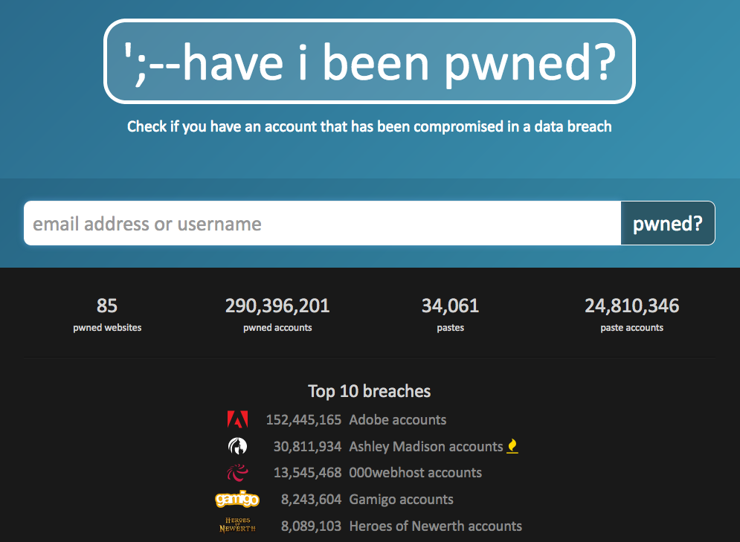
Last year…
Notes:
Here is a snapshot of western europe at a specific time. Each one of these blue point is a car with people sharing a trip. In Berlin specifically tonight two cars will be leaving every minute from 270 different departing points.

Slide 21
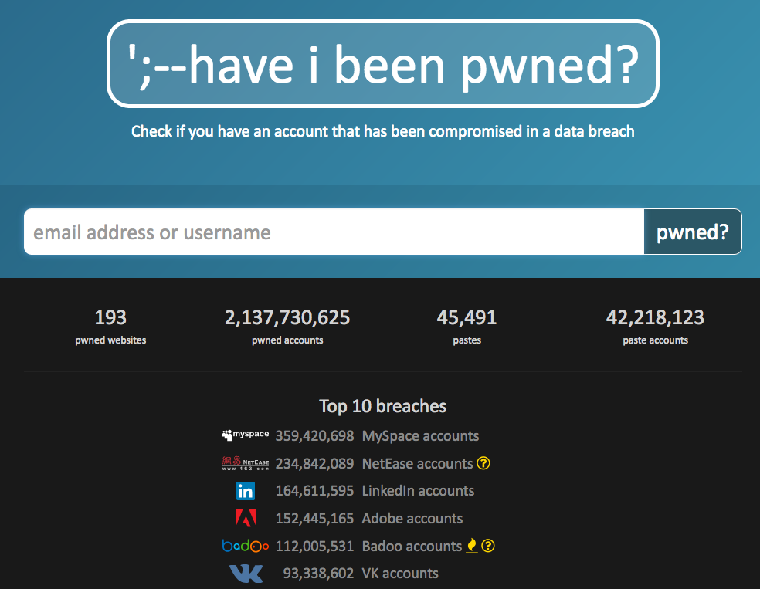
Now!
Notes:
Here is a snapshot of western europe at a specific time. Each one of these blue point is a car with people sharing a trip. In Berlin specifically tonight two cars will be leaving every minute from 270 different departing points.

Slide 22

Password Reuse Attack

Slide 23
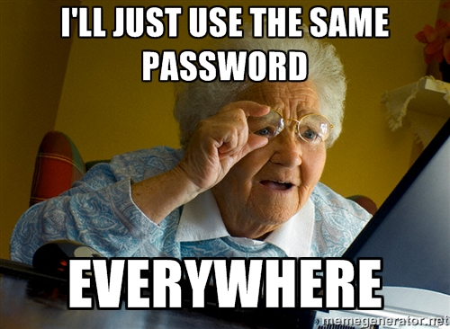
Most users use the same password everywhere
Notes:
Here is a snapshot of western europe at a specific time. Each one of these blue point is a car with people sharing a trip. In Berlin specifically tonight two cars will be leaving every minute from 270 different departing points.

Slide 24
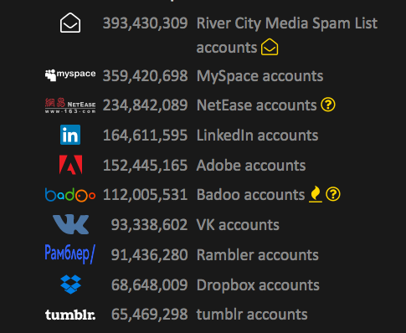
Companies databases get compromised
Notes:
Here is a snapshot of western europe at a specific time. Each one of these blue point is a car with people sharing a trip. In Berlin specifically tonight two cars will be leaving every minute from 270 different departing points.

Slide 25
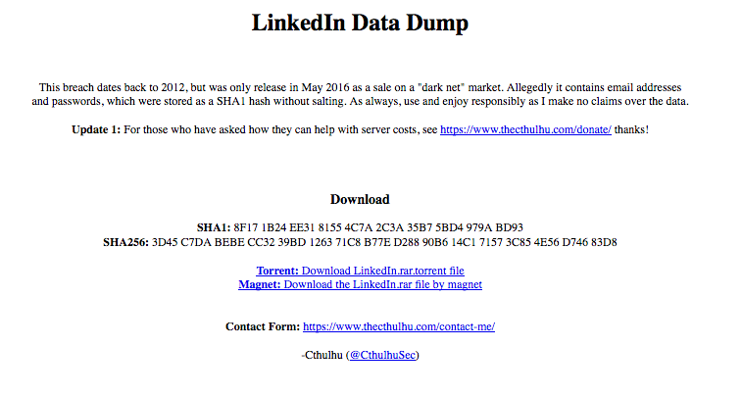
They can be downloaded by anyone
Notes:
Here is a snapshot of western europe at a specific time. Each one of these blue point is a car with people sharing a trip. In Berlin specifically tonight two cars will be leaving every minute from 270 different departing points.

Slide 26
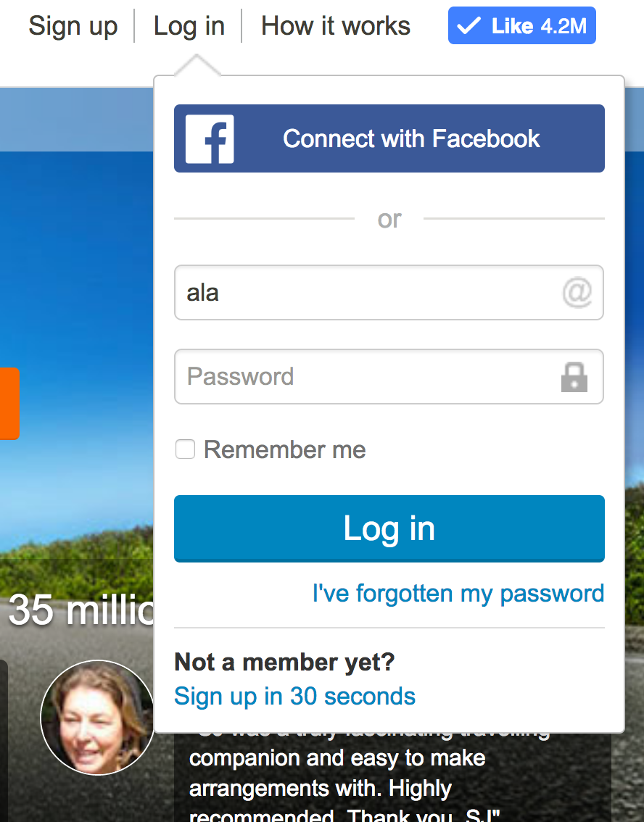
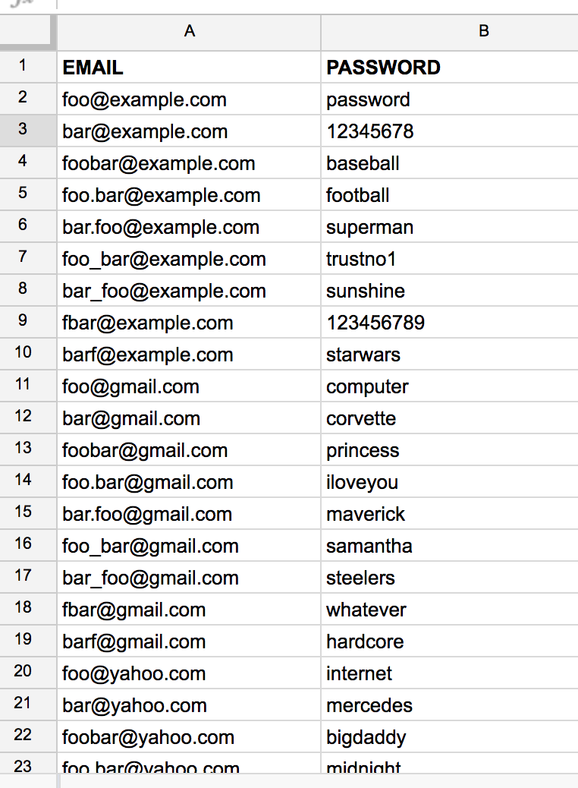
Passwords can be reused!
Notes:
Here is a snapshot of western europe at a specific time. Each one of these blue point is a car with people sharing a trip. In Berlin specifically tonight twob cars will be leaving every minute from 270 different departing points.

Slide 27
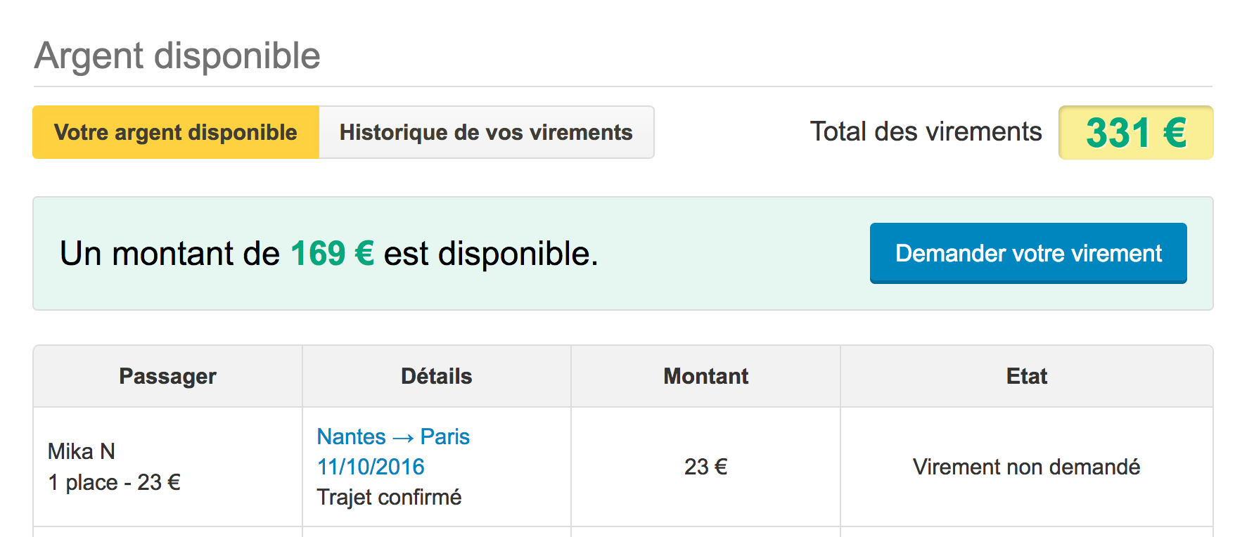
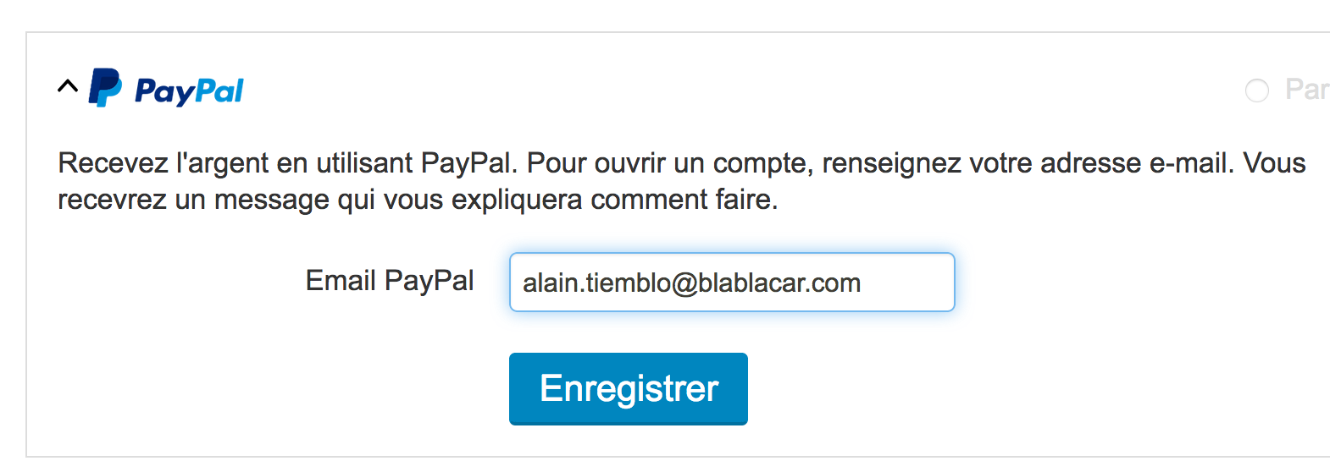

And when they succeed...

Slide 28
How to protect our applications?

Slide 29
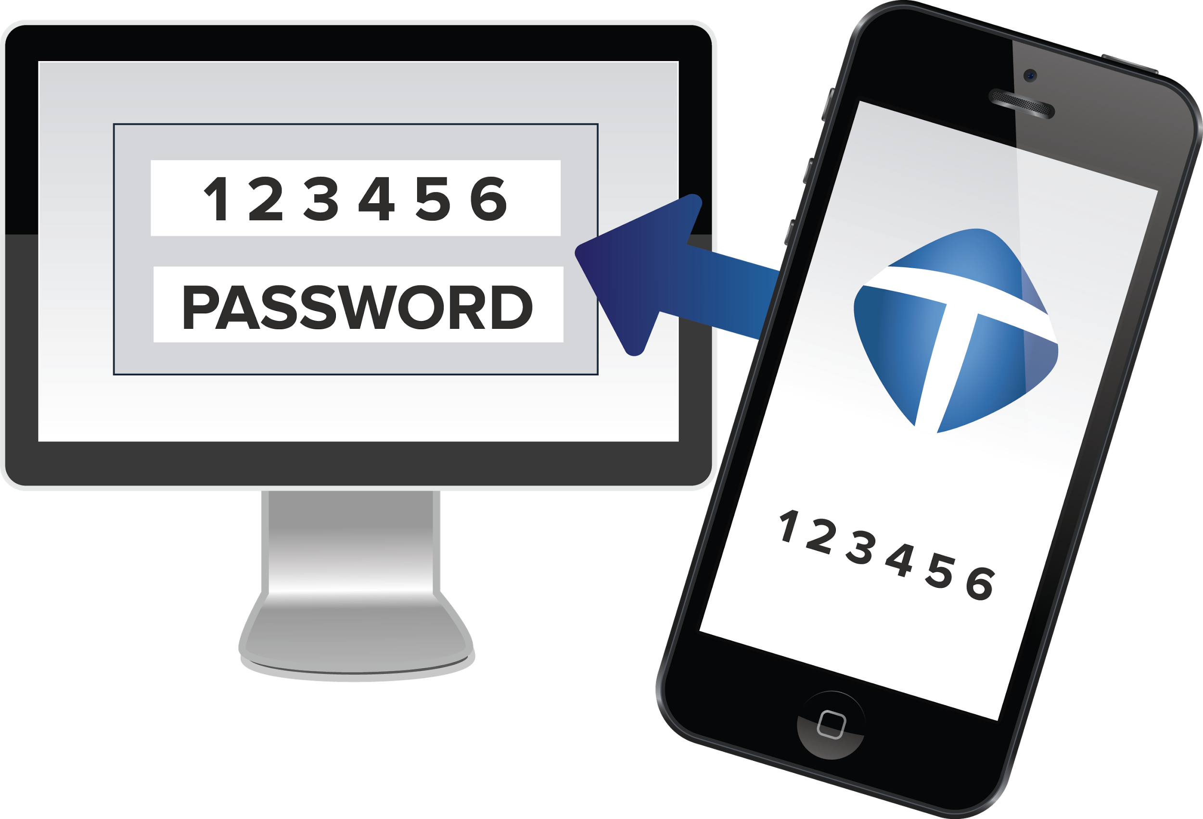
Multi-factor authentication
Notes:
Here is a snapshot of western europe at a specific time. Each one of these blue point is a car with people sharing a trip. In Berlin specifically tonight two cars will be leaving every minute from 270 different departing points.

Slide 30
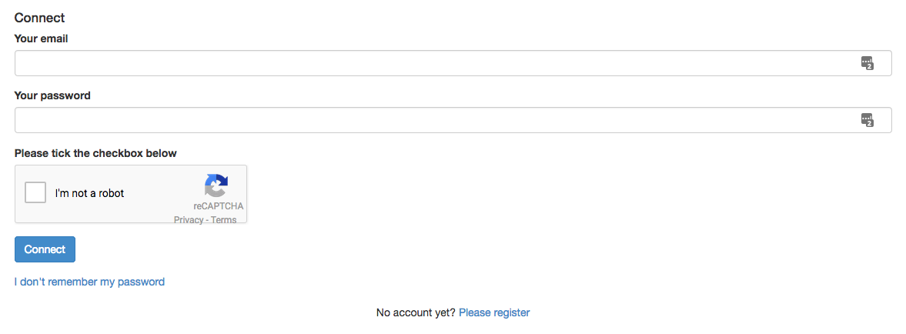
Captcha
Notes:
Here is a snapshot of western europe at a specific time. Each one of these blue point is a car with people sharing a trip. In Berlin specifically tonight two cars will be leaving every minute from 270 different departing points.

Slide 31

Enforce password change in a regular basis
Notes:
Here is a snapshot of western europe at a specific time. Each one of these blue point is a car with people sharing a trip. In Berlin specifically tonight two cars will be leaving every minute from 270 different departing points.

Slide 32

Delegate sign-in to others ❤️
Notes:
Here is a snapshot of western europe at a specific time. Each one of these blue point is a car with people sharing a trip. In Berlin specifically tonight two cars will be leaving every minute from 270 different departing points.

Slide 33
How to protect our family & friends?
Spread the word!

Slide 34
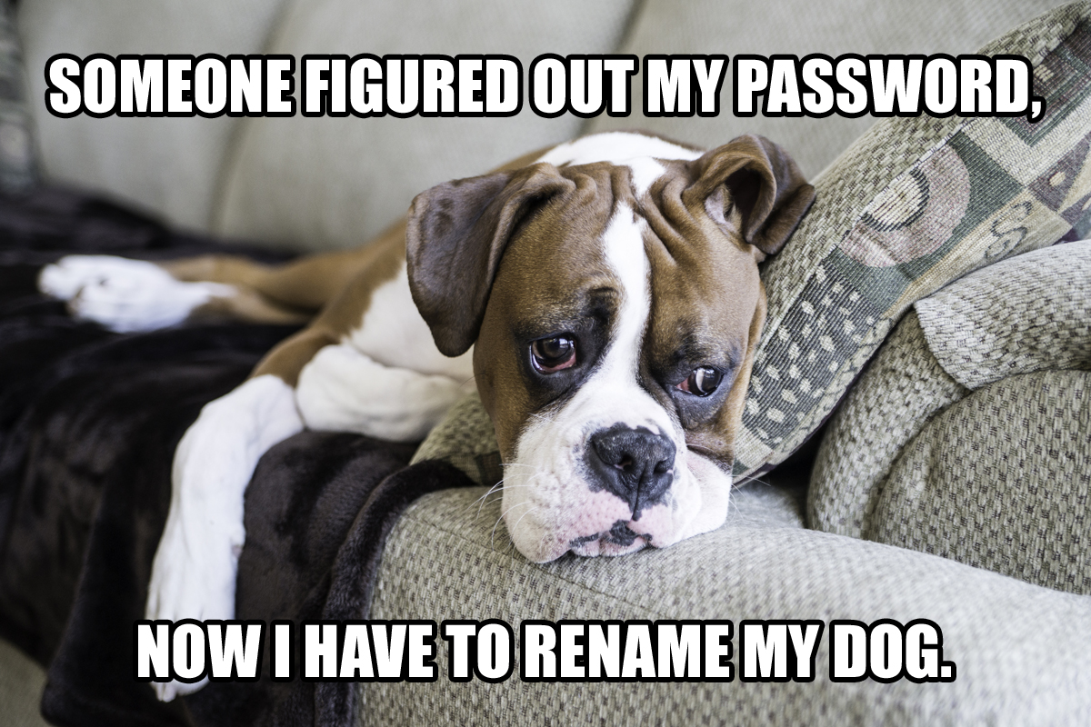
Don’t use guessable passwords
Notes:
Here is a snapshot of western europe at a specific time. Each one of these blue point is a car with people sharing a trip. In Berlin specifically tonight two cars will be leaving every minute from 270 different departing points.

Slide 35
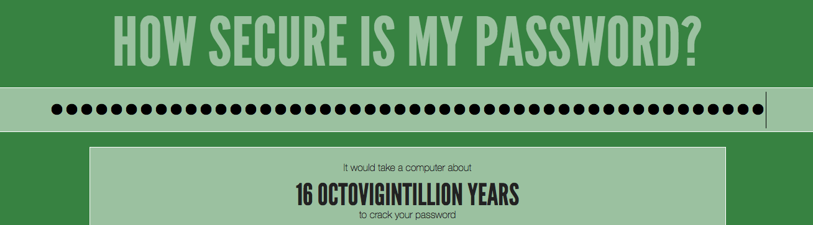
https://HowSecureIsMyPassword.net
Check your password strength
Notes:
Here is a snapshot of western europe at a specific time. Each one of these blue point is a car with people sharing a trip. In Berlin specifically tonight two cars will be leaving every minute from 270 different departing points.

Slide 36
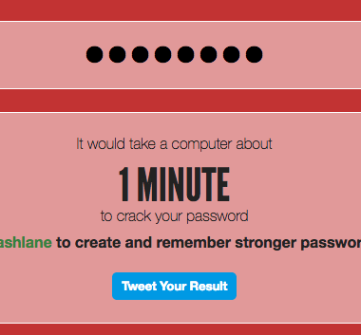
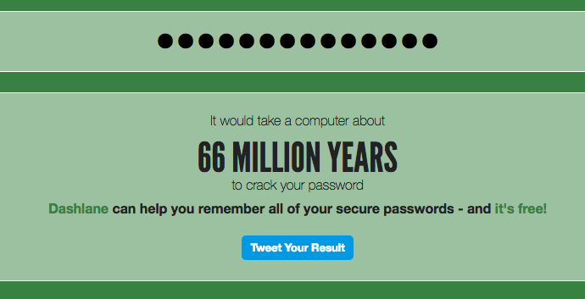
banana75
I love fruit.
Prefer a passphrase
Notes:
Here is a snapshot of western europe at a specific time. Each one of these blue point is a car with people sharing a trip. In Berlin specifically tonight two cars will be leaving every minute from 270 different departing points.

Slide 37





banana75
tbanana75r
banana75
fbanana75k
banana75
bbanana75r
One unique password per website
Notes:
Here is a snapshot of western europe at a specific time. Each one of these blue point is a car with people sharing a trip. In Berlin specifically tonight two cars will be leaving every minute from 270 different departing points.

Slide 38
I love fruit.
I love twitter’s fruit.
I love fruit.
I love facebook’s fruit.
I love fruit.
I love blablacar’s fruit.
Notes:
Here is a snapshot of western europe at a specific time. Each one of these blue point is a car with people sharing a trip. In Berlin specifically tonight two cars will be leaving every minute from 270 different departing points.

Slide 39







Use a password manager
Notes:
Here is a snapshot of western europe at a specific time. Each one of these blue point is a car with people sharing a trip. In Berlin specifically tonight two cars will be leaving every minute from 270 different departing points.

Slide 40
Other password reuse attack factors

Slide 41
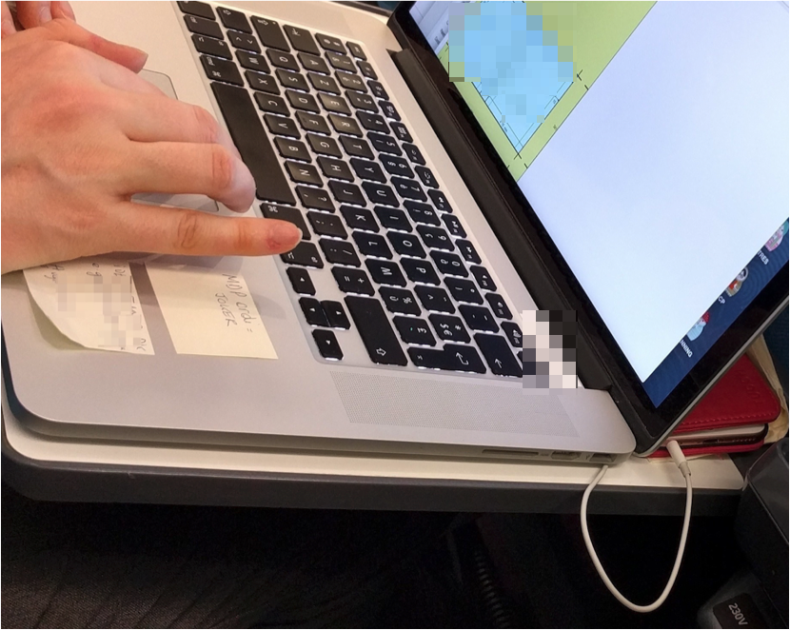
Passwords on a post-it ❤️
Notes:
Here is a snapshot of western europe at a specific time. Each one of these blue point is a car with people sharing a trip. In Berlin specifically tonight two cars will be leaving every minute from 270 different departing points.

Slide 42
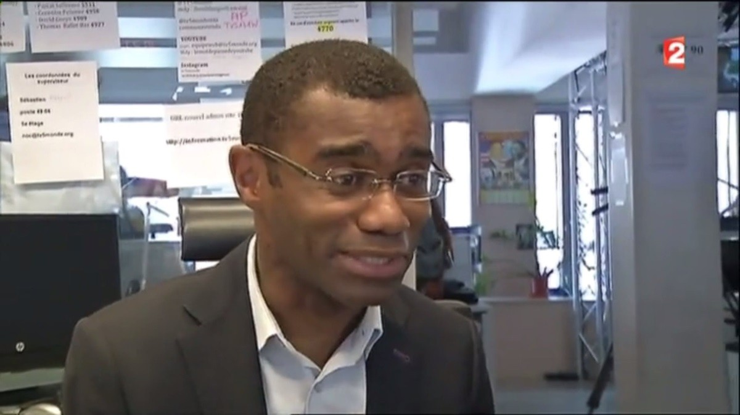
Passwords on walls
Notes:
Here is a snapshot of western europe at a specific time. Each one of these blue point is a car with people sharing a trip. In Berlin specifically tonight two cars will be leaving every minute from 270 different departing points.

Slide 43
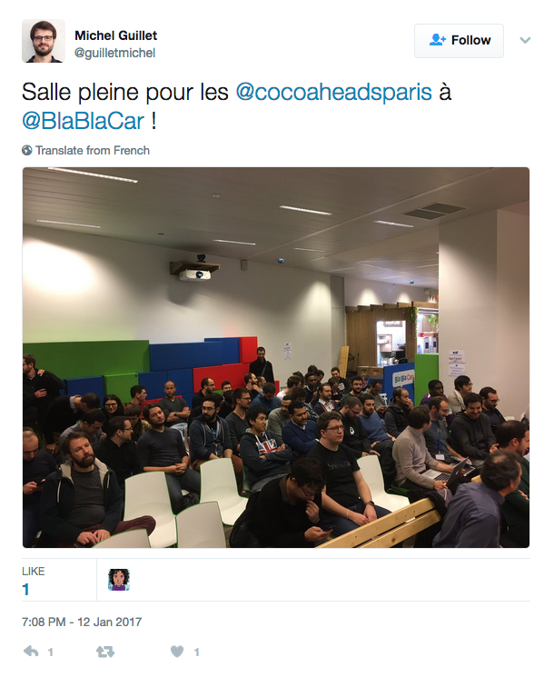
WiFi passwords on walls
Notes:
Here is a snapshot of western europe at a specific time. Each one of these blue point is a car with people sharing a trip. In Berlin specifically tonight two cars will be leaving every minute from 270 different departing points.

Slide 44
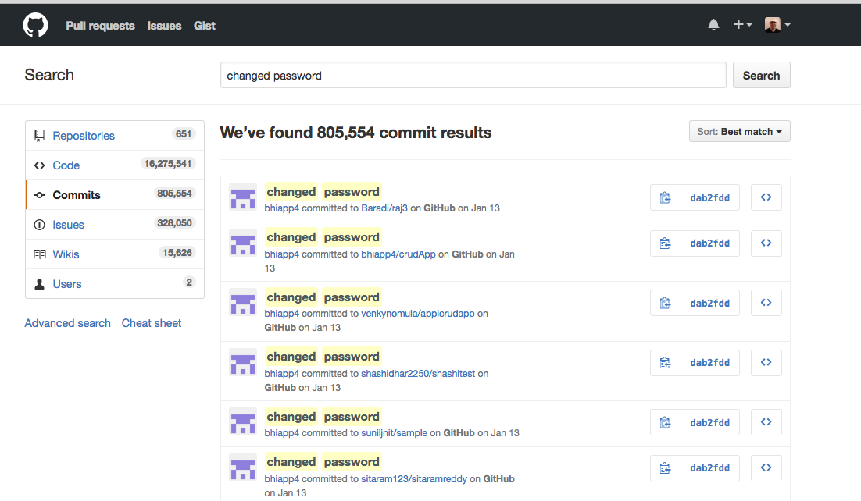

Production passwords on GitHub
Notes:
Here is a snapshot of western europe at a specific time. Each one of these blue point is a car with people sharing a trip. In Berlin specifically tonight two cars will be leaving every minute from 270 different departing points.

Slide 45
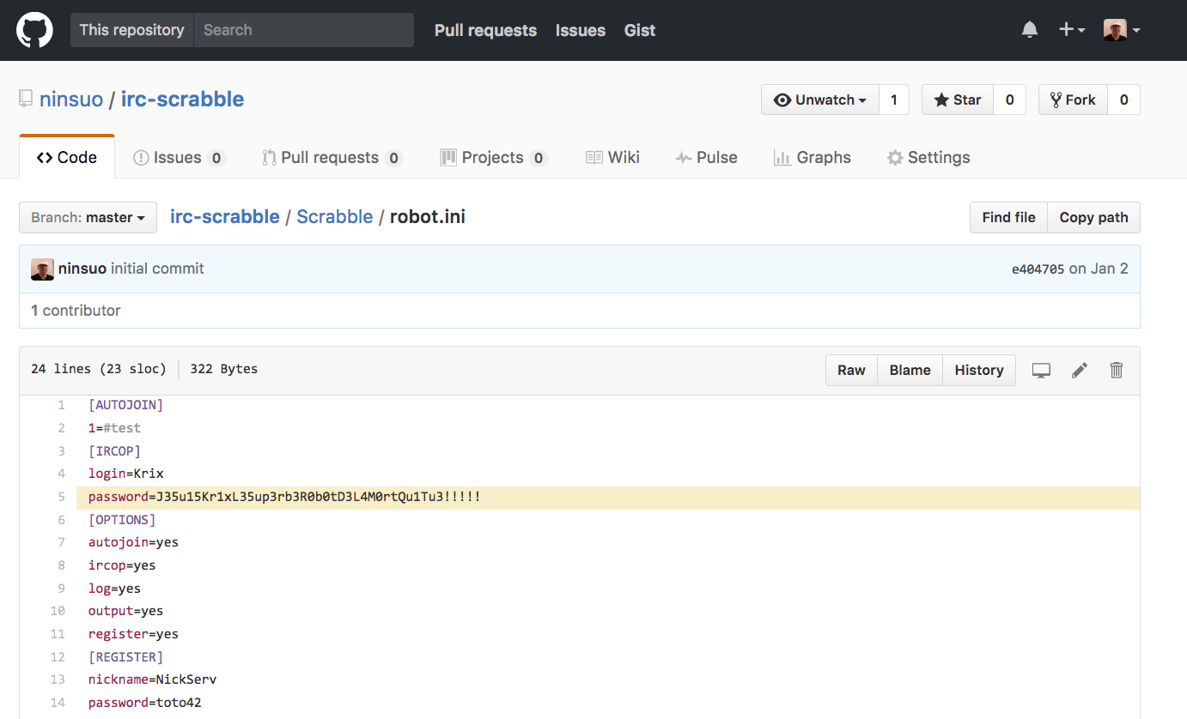

Notes:
Here is a snapshot of western europe at a specific time. Each one of these blue point is a car with people sharing a trip. In Berlin specifically tonight two cars will be leaving every minute from 270 different departing points.

Slide 46
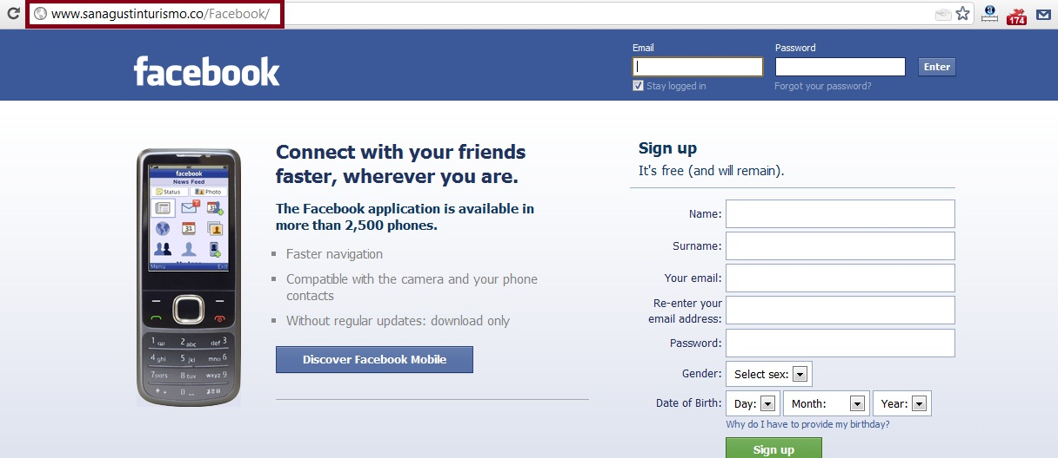
Phishing
Notes:
Here is a snapshot of western europe at a specific time. Each one of these blue point is a car with people sharing a trip. In Berlin specifically tonight two cars will be leaving every minute from 270 different departing points.

Slide 47

Passwords on...
Notes:
Here is a snapshot of western europe at a specific time. Each one of these blue point is a car with people sharing a trip. In Berlin specifically tonight two cars will be leaving every minute from 270 different departing points.

Slide 48
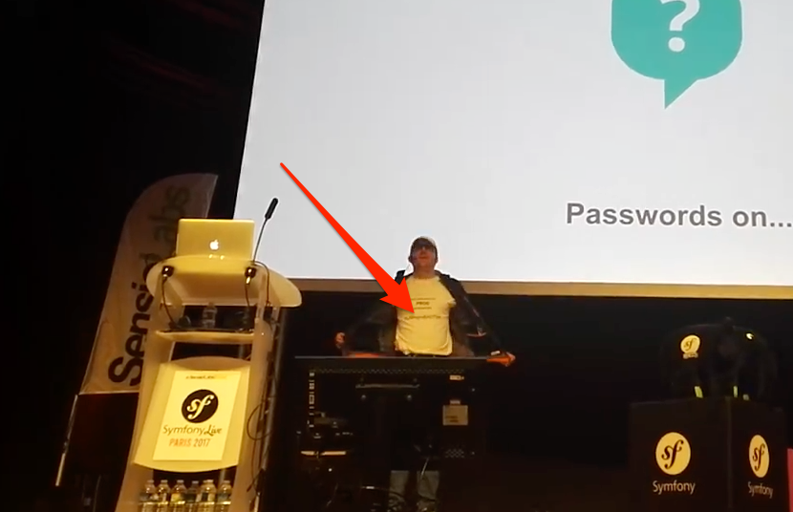
Passwords on...
Notes:
Here is a snapshot of western europe at a specific time. Each one of these blue point is a car with people sharing a trip. In Berlin specifically tonight two cars will be leaving every minute from 270 different departing points.

Slide 49
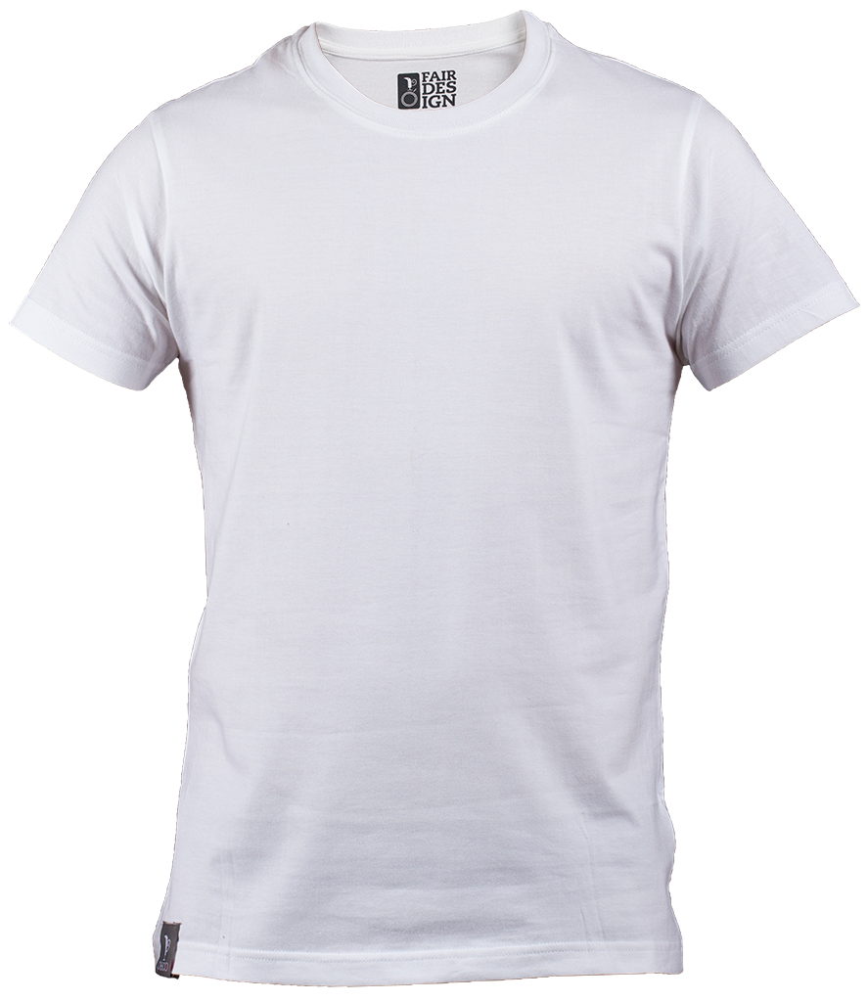

Notes:
Here is a snapshot of western europe at a specific time. Each one of these blue point is a car with people sharing a trip. In Berlin specifically tonight two cars will be leaving every minute from 270 different departing points.

Slide 50
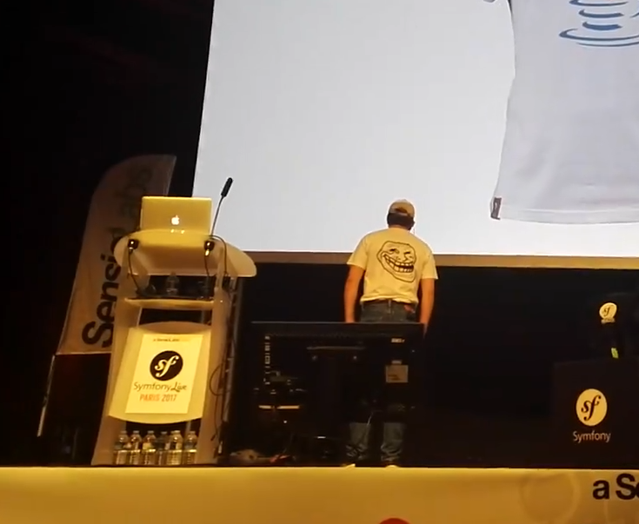
Notes:
Here is a snapshot of western europe at a specific time. Each one of these blue point is a car with people sharing a trip. In Berlin specifically tonight two cars will be leaving every minute from 270 different departing points.

Slide 51
Captcha Cracking

Slide 52
Completely Automated Public Turing test to tell Computers and Humans Apart
Notes:
Here is a snapshot of western europe at a specific time. Each one of these blue point is a car with people sharing a trip. In Berlin specifically tonight two cars will be leaving every minute from 270 different departing points.

Slide 53
Method #1
The Geeky way

Slide 54

Capcha is made black & white
Notes:
Here is a snapshot of western europe at a specific time. Each one of these blue point is a car with people sharing a trip. In Berlin specifically tonight two cars will be leaving every minute from 270 different departing points.

Slide 55

No need to work on large images, reduce it enough
Notes:
Here is a snapshot of western europe at a specific time. Each one of these blue point is a car with people sharing a trip. In Berlin specifically tonight two cars will be leaving every minute from 270 different departing points.

Slide 56
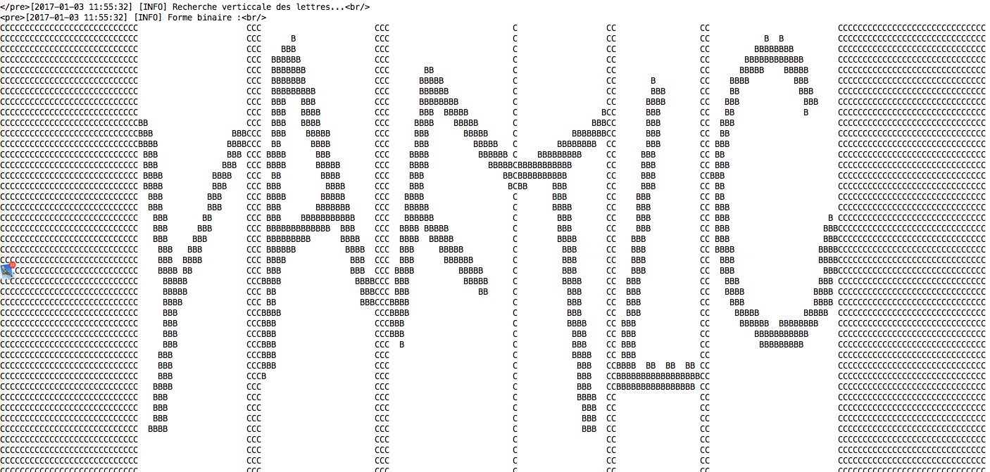
Look for spaces between letters
Notes:
Here is a snapshot of western europe at a specific time. Each one of these blue point is a car with people sharing a trip. In Berlin specifically tonight two cars will be leaving every minute from 270 different departing points.

Slide 57
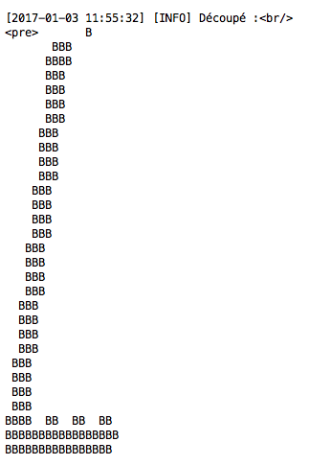
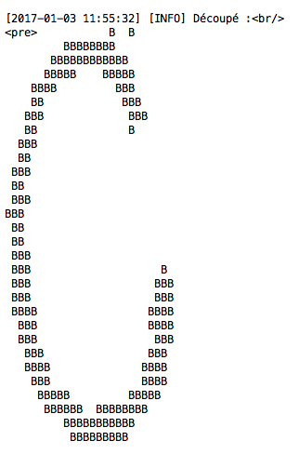
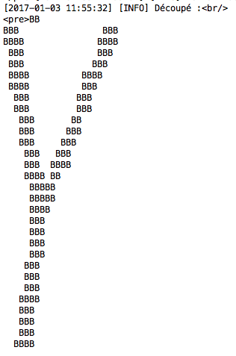
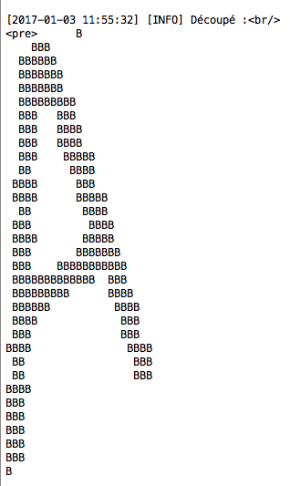
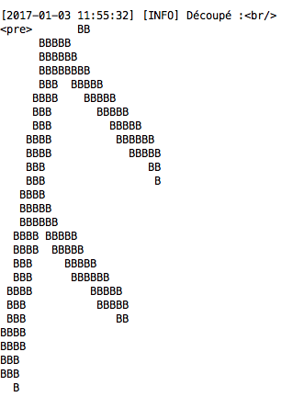
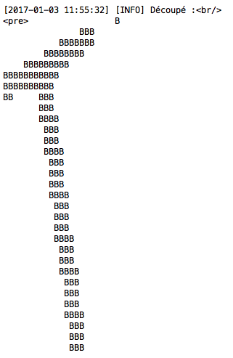
Cut
Notes:
Here is a snapshot of western europe at a specific time. Each one of these blue point is a car with people sharing a trip. In Berlin specifically tonight two cars will be leaving every minute from 270 different departing points.

Slide 58










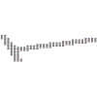



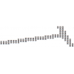









Get each letter rotated from 0” to 359”
Notes:
Here is a snapshot of western europe at a specific time. Each one of these blue point is a car with people sharing a trip. In Berlin specifically tonight two cars will be leaving every minute from 270 different departing points.

Slide 59
BBB
BBBBBBB
BBBBBBBB
AAAAVVVVVVVVVA
VVVVVVVVVVVAAA
VVVVVVVVVVAAAA
BBBVVA
BVVA
VVV
VVV
VVV
VVVB
AVVB
AVVB
AVVB
AVVBB
AAVBB
AAVBB
AAVBB
AAABBB
AAABBB
AAABBB
AAABBBB
AAA BBB
AAA BBB
AAA BBB
AAA BBBB
AAA BBB
AAA BBB
AAA BBB
A = known dictionary
B = character to test
V = common part
Compare each rotated char with known dictionary
Notes:
Here is a snapshot of western europe at a specific time. Each one of these blue point is a car with people sharing a trip. In Berlin specifically tonight two cars will be leaving every minute from 270 different departing points.

Slide 60
VVVVVVVVVVVVVV
BVVVVVVVVVVVVVA
BBVVVVVVVVVVVVAA
VVV
VVV
VVV
VVV
VVV
VVV
VVV
VVV
VVV
VVV
VVV
VVV
VVV
VVV
VVV
VVV
VVV
VVV
VVV
VVV
VVV
VVV
BB
B
A = known dictionary
B = character to test
V = common part
Matching character is the one having higher common part
Notes:
Here is a snapshot of western europe at a specific time. Each one of these blue point is a car with people sharing a trip. In Berlin specifically tonight two cars will be leaving every minute from 270 different departing points.

Slide 61
Method #2
The Lazy way

Slide 62
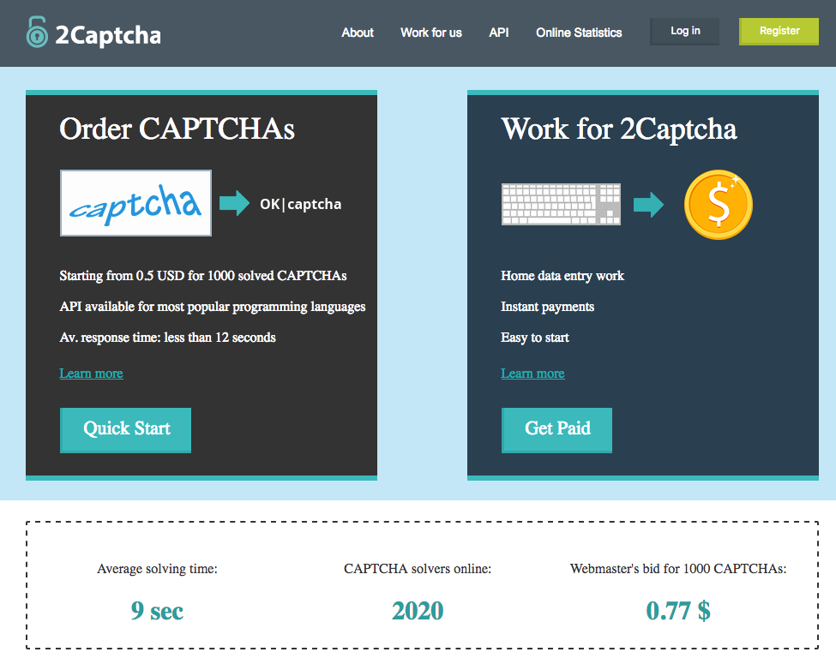
Pay people to fill your captcha 🤔
Notes:
Here is a snapshot of western europe at a specific time. Each one of these blue point is a car with people sharing a trip. In Berlin specifically tonight two cars will be leaving every minute from 270 different departing points.

Slide 63
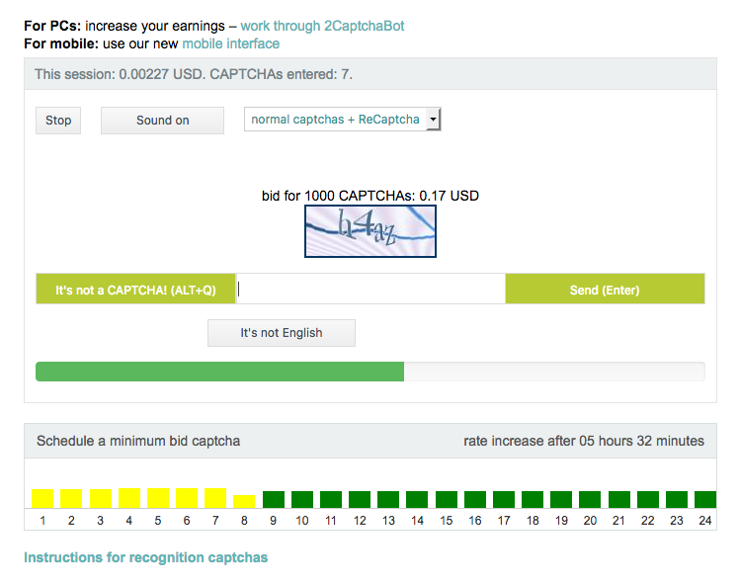
I’ve earned 0.00227 USD for 7 captchas 😅
Notes:
Here is a snapshot of western europe at a specific time. Each one of these blue point is a car with people sharing a trip. In Berlin specifically tonight two cars will be leaving every minute from 270 different departing points.

Slide 64
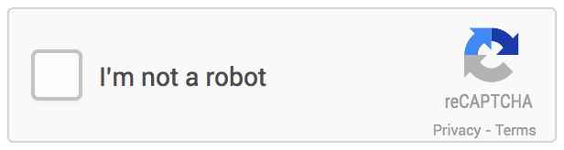
Also works for reCaptcha
Notes:
Here is a snapshot of western europe at a specific time. Each one of these blue point is a car with people sharing a trip. In Berlin specifically tonight two cars will be leaving every minute from 270 different departing points.

Slide 65

But paid application
Notes:
Here is a snapshot of western europe at a specific time. Each one of these blue point is a car with people sharing a trip. In Berlin specifically tonight two cars will be leaving every minute from 270 different departing points.

Slide 66
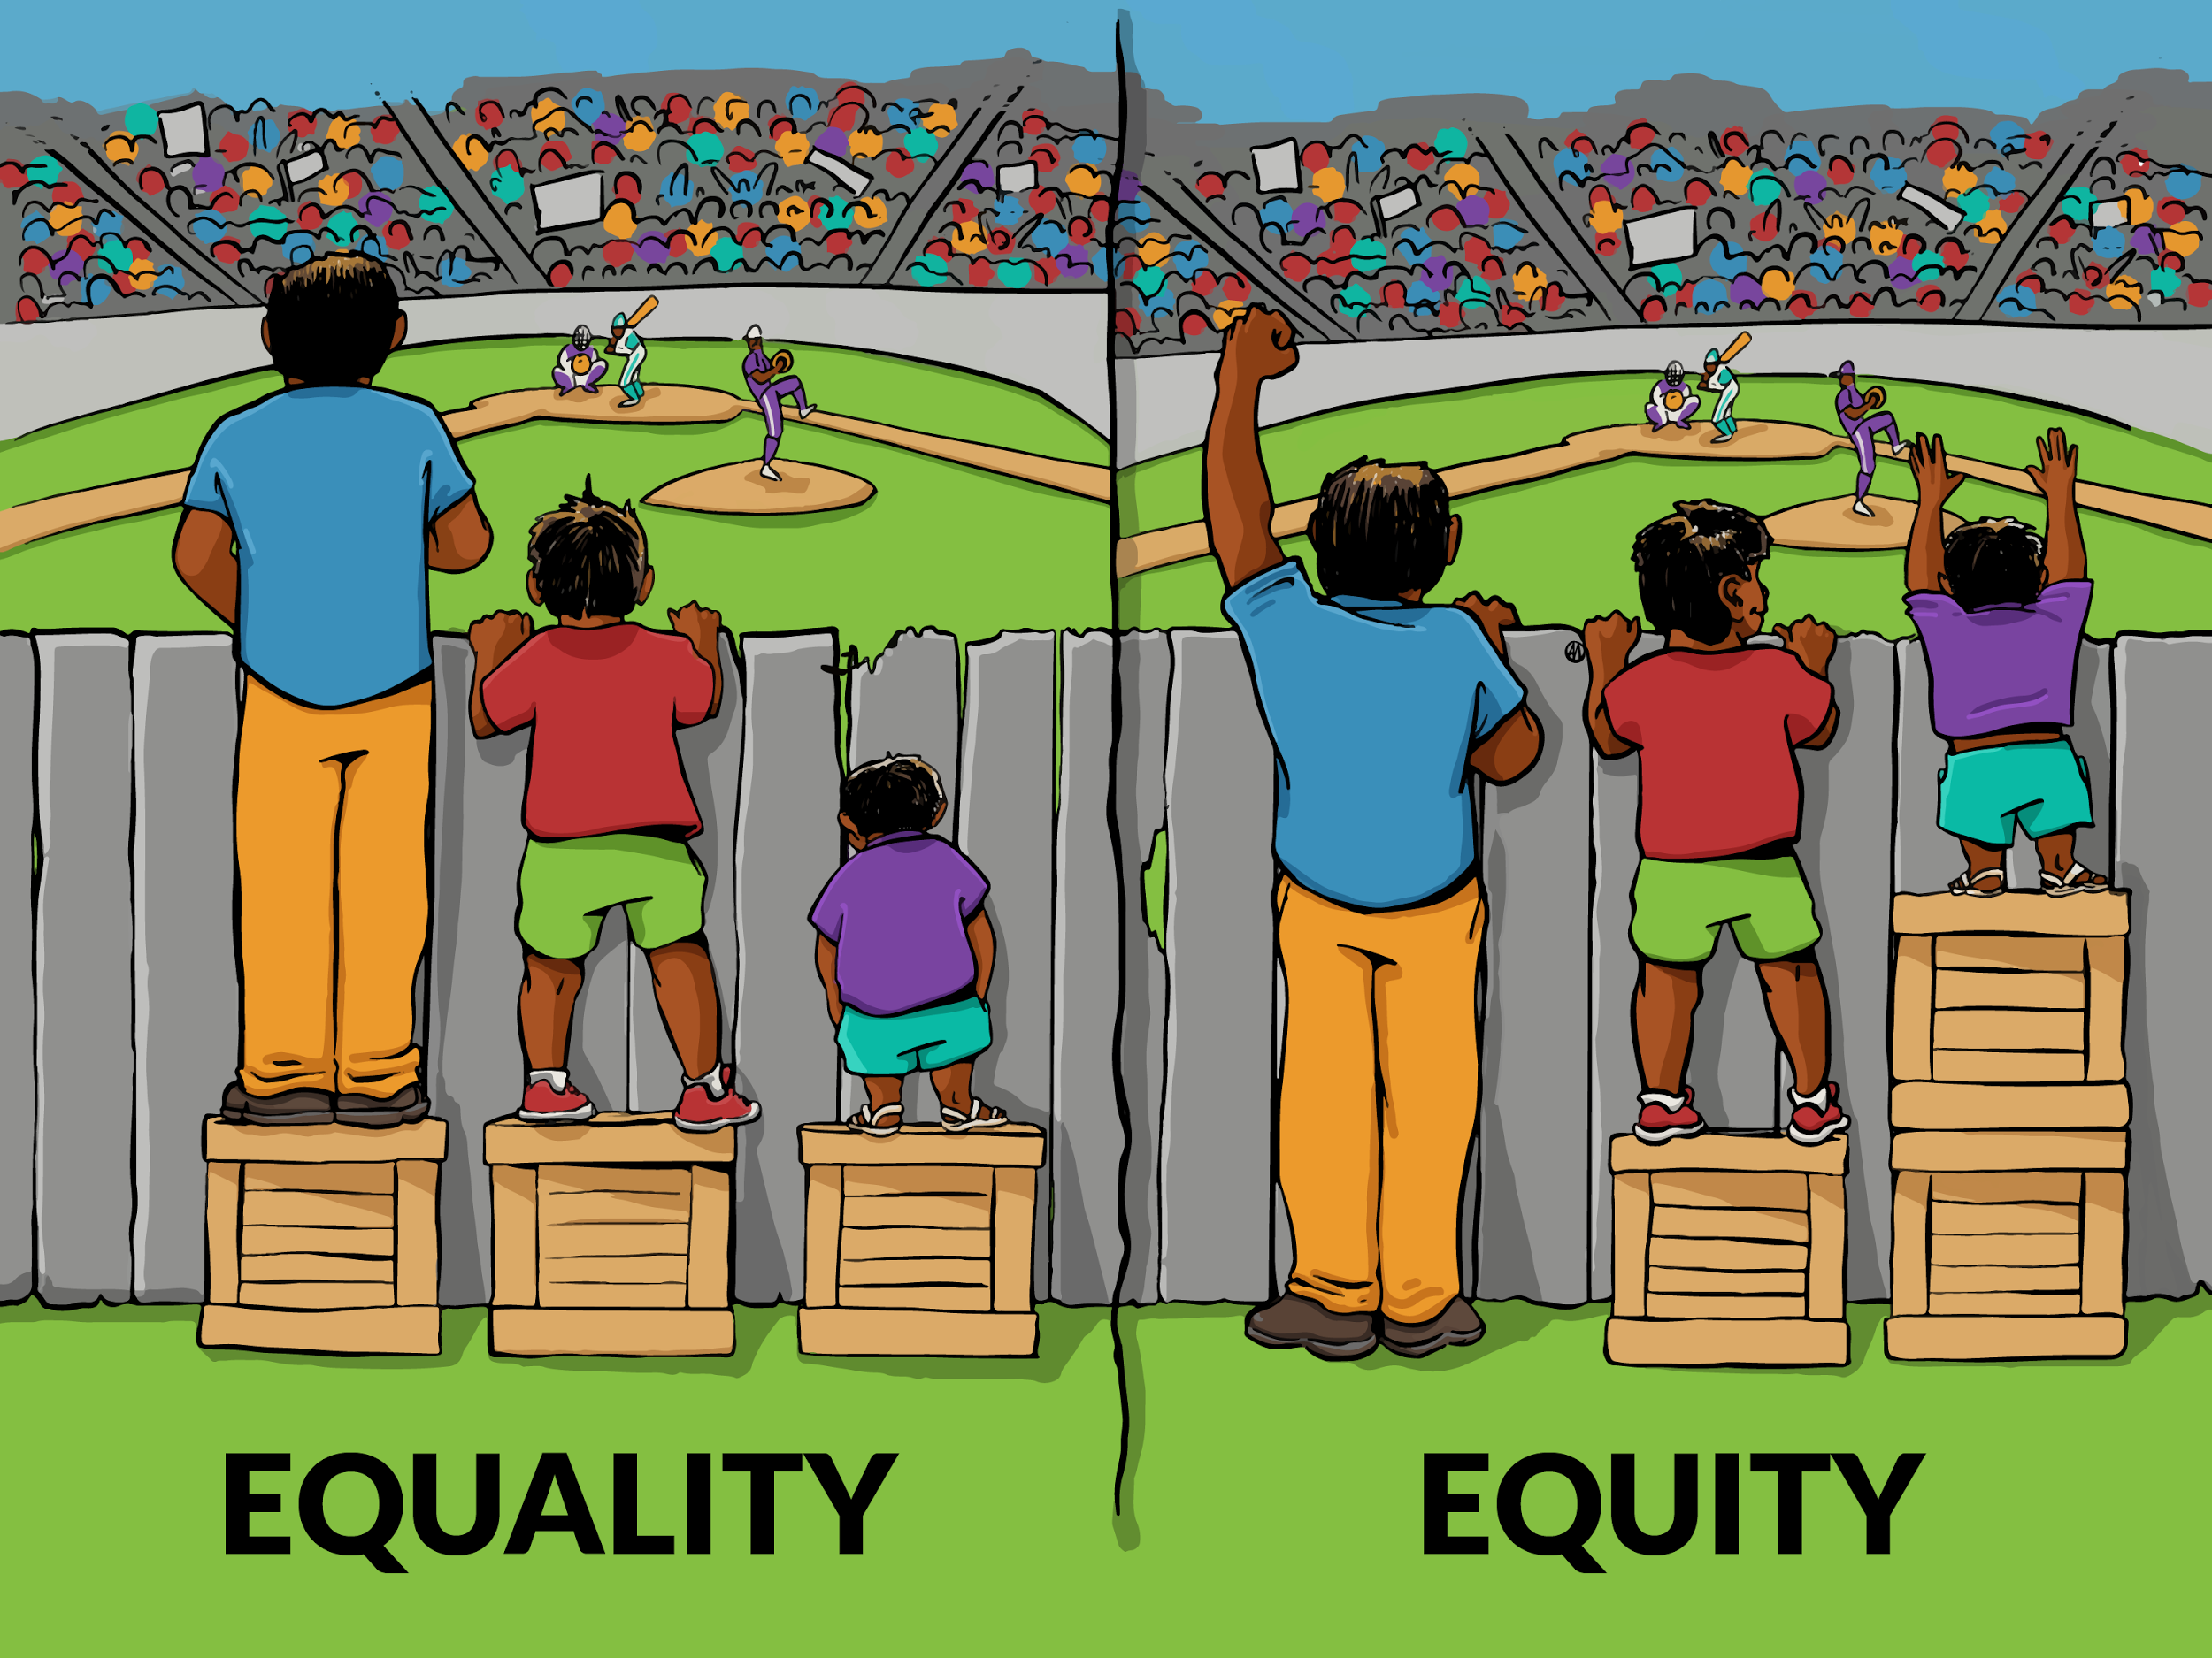
And questionable equity
Notes:
Here is a snapshot of western europe at a specific time. Each one of these blue point is a car with people sharing a trip. In Berlin specifically tonight two cars will be leaving every minute from 270 different departing points.

Slide 67
MySQL injections

Slide 68

Everyone knows Bobby!
Notes:
Here is a snapshot of western europe at a specific time. Each one of these blue point is a car with people sharing a trip. In Berlin specifically tonight two cars will be leaving every minute from 270 different departing points.

Slide 69
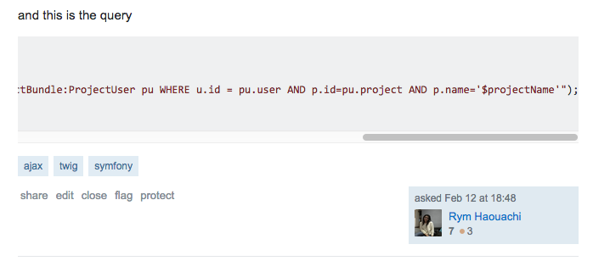
… or not
Notes:
Here is a snapshot of western europe at a specific time. Each one of these blue point is a car with people sharing a trip. In Berlin specifically tonight two cars will be leaving every minute from 270 different departing points.

Slide 70
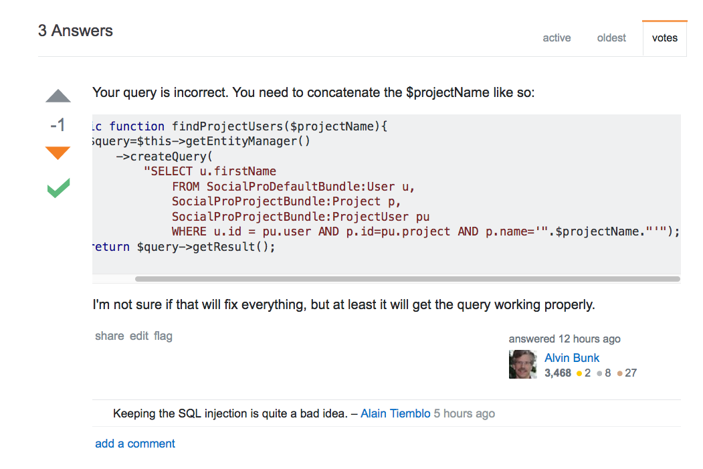
An associated answer to this recent question
Notes:
Here is a snapshot of western europe at a specific time. Each one of these blue point is a car with people sharing a trip. In Berlin specifically tonight two cars will be leaving every minute from 270 different departing points.

Slide 71
$connection->fetchAssoc('
SELECT * FROM user WHERE username = "$username" AND password = "$password"
');
With $username = 'admin"-- '
SELECT * FROM user WHERE username = "admin"-- " AND password = ""
Let’s be admin
Notes:
Here is a snapshot of western europe at a specific time. Each one of these blue point is a car with people sharing a trip. In Berlin specifically tonight two cars will be leaving every minute from 270 different departing points.

Slide 72
$connection->fetchAll('
SELECT * FROM product WHERE shop_id = "{$_GET[‘shop_id’]}"
');
Getting to /products.php?shop_id=42 OR 1=1
SELECT * FROM product WHERE shop_id = 42 OR 1=1
Let’s access everything
Notes:
Here is a snapshot of western europe at a specific time. Each one of these blue point is a car with people sharing a trip. In Berlin specifically tonight two cars will be leaving every minute from 270 different departing points.

Slide 73
$connection->execute('
DELETE FROM product WHERE id = "{$_GET[‘id’]}"
');
Getting to /delete_product.php?id=42 OR 1=1
DELETE FROM product WHERE id = 42 OR 1=1
Let’s delete everything
Notes:
Here is a snapshot of western europe at a specific time. Each one of these blue point is a car with people sharing a trip. In Berlin specifically tonight two cars will be leaving every minute from 270 different departing points.

Slide 74
With $username = 'admin"--/**/'
SELECT * FROM user WHERE username = "admin"--/**/" AND password = ""
If spaces are sanitized, use /**/
Notes:
Here is a snapshot of western europe at a specific time. Each one of these blue point is a car with people sharing a trip. In Berlin specifically tonight two cars will be leaving every minute from 270 different departing points.

Slide 75
With $username = '" UNION SELECT * FROM admin-- '
SELECT * FROM user WHERE username = ""
UNION
SELECT * FROM admin-- " AND password=""
Use UNION to take over other tables
Notes:
Here is a snapshot of western europe at a specific time. Each one of these blue point is a car with people sharing a trip. In Berlin specifically tonight two cars will be leaving every minute from 270 different departing points.

Slide 76
With $username = '" UNION SELECT table_name as id FROM information_schema.tables-- '
SELECT id FROM users WHERE username = ""
UNION
SELECT table_name as id FROM information_schema.tables-- " AND password=""
… and discover the schema
Notes:
Here is a snapshot of western europe at a specific time. Each one of these blue point is a car with people sharing a trip. In Berlin specifically tonight two cars will be leaving every minute from 270 different departing points.

Slide 77
$connection->fetchAssoc('
SELECT * FROM user WHERE username = :username AND password = :password
', [ 'username' => $username, 'password' => $password, ]);
In any way, use prepared statements
Notes:
Here is a snapshot of western europe at a specific time. Each one of these blue point is a car with people sharing a trip. In Berlin specifically tonight two cars will be leaving every minute from 270 different departing points.

Slide 78
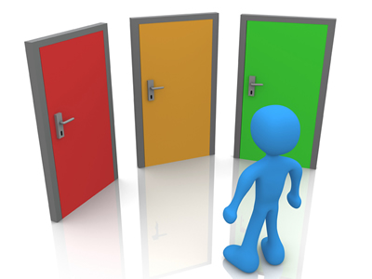
Redirect Attacks

Slide 79
Redirect attack principle
1
You need to redirect your member to a specific page after he successfully logs in.
2
Attacker will use your redirection strategy with malicious URL to gather personal information (credentials, …) using a phishing website.

Slide 80
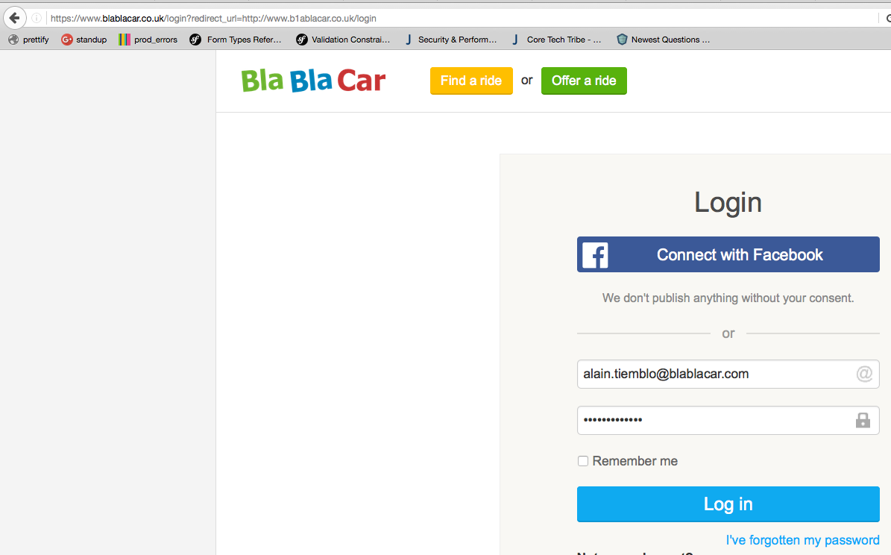
Notes:
Here is a snapshot of western europe at a specific time. Each one of these blue point is a car with people sharing a trip. In Berlin specifically tonight two cars will be leaving every minute from 270 different departing points.

Slide 81
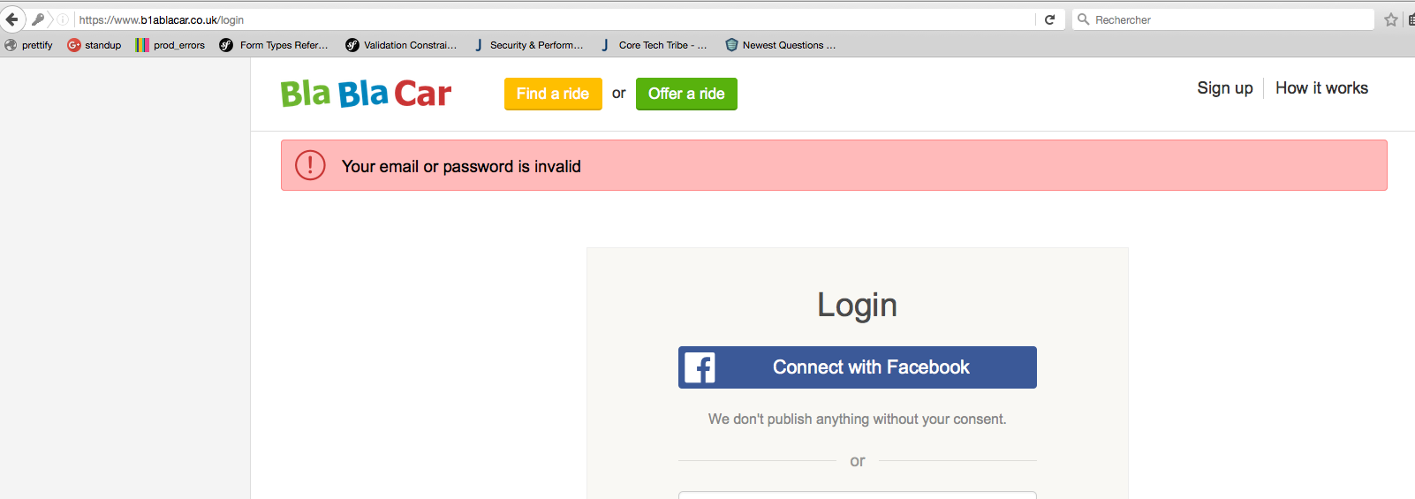
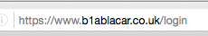
Notes:
Here is a snapshot of western europe at a specific time. Each one of these blue point is a car with people sharing a trip. In Berlin specifically tonight two cars will be leaving every minute from 270 different departing points.

Slide 82
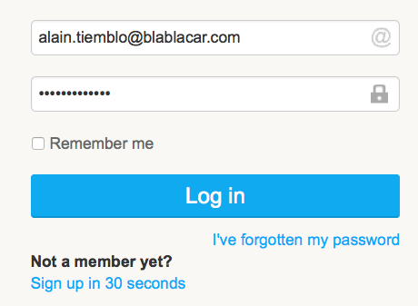

Notes:
Here is a snapshot of western europe at a specific time. Each one of these blue point is a car with people sharing a trip. In Berlin specifically tonight two cars will be leaving every minute from 270 different departing points.

Slide 83
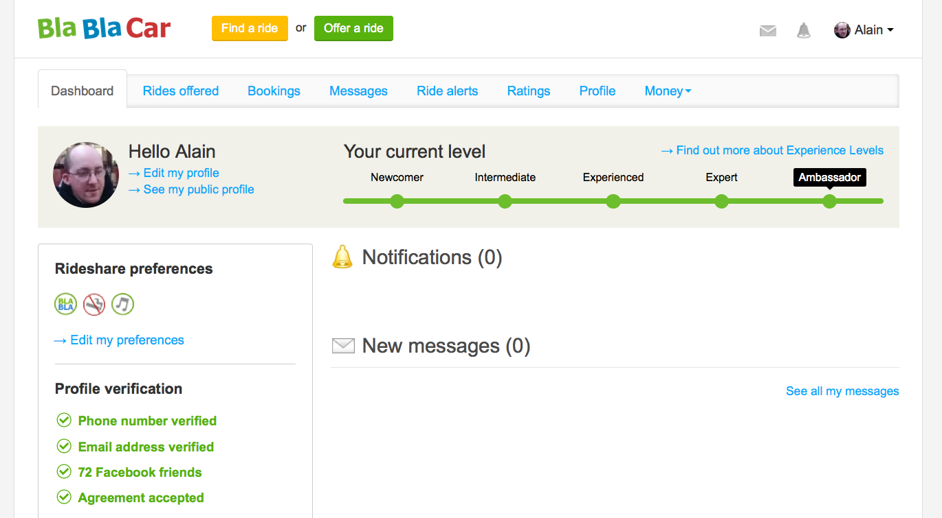
Notes:
Here is a snapshot of western europe at a specific time. Each one of these blue point is a car with people sharing a trip. In Berlin specifically tonight two cars will be leaving every minute from 270 different departing points.

Slide 84

Solution:
Put redirection URLs in a white list.
Notes:
Here is a snapshot of western europe at a specific time. Each one of these blue point is a car with people sharing a trip. In Berlin specifically tonight two cars will be leaving every minute from 270 different departing points.

Slide 85
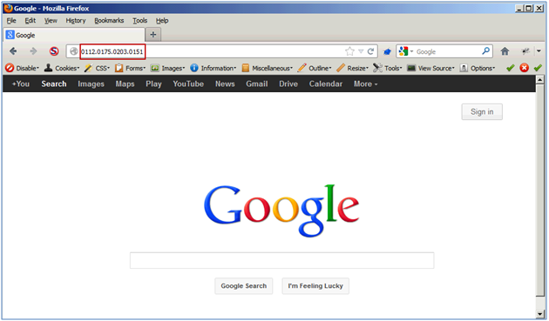
URL obfuscation

Slide 86
URL obfuscation principle
1
Attacker wants to bypass spam filters or put an URL somewhere without drawing attention
2
He will encode the URL’s host, or convert the target ip to something more discreet (an integer, a hexadecimal number…)

Slide 87
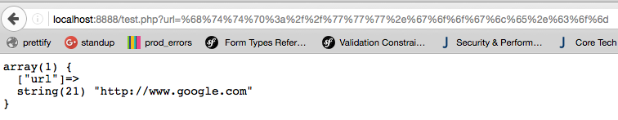
URL encoding:
Notes:
Here is a snapshot of western europe at a specific time. Each one of these blue point is a car with people sharing a trip. In Berlin specifically tonight two cars will be leaving every minute from 270 different departing points.

Slide 88



IP conversion
Decimal
Octal
Hexadecimal
Notes:
Here is a snapshot of western europe at a specific time. Each one of these blue point is a car with people sharing a trip. In Berlin specifically tonight two cars will be leaving every minute from 270 different departing points.

Slide 89

Altogether...
Notes:
Here is a snapshot of western europe at a specific time. Each one of these blue point is a car with people sharing a trip. In Berlin specifically tonight two cars will be leaving every minute from 270 different departing points.

Slide 90

Notes:
Here is a snapshot of western europe at a specific time. Each one of these blue point is a car with people sharing a trip. In Berlin specifically tonight two cars will be leaving every minute from 270 different departing points.

Slide 91

Notes:
Here is a snapshot of western europe at a specific time. Each one of these blue point is a car with people sharing a trip. In Berlin specifically tonight two cars will be leaving every minute from 270 different departing points.

Slide 92
Do not use public URL shorteners
1
That’s easy to fake, nobody will see the difference between bit.ly/xZahhGfk and bit.ly/BJzENdJq
2
That’s easy to bruteforce, many private documents were accessed by crawling possible combinations
3
In any way, think twice before opening shortened links

Slide 93
Use your own URL shortener
At BlaBlaCar, we use blbl.cr, for example:
http://blbl.cr/symfony
This one is easy to fake by using typosquatting attacks though.

Slide 94



Man-in-the-Middle Attacks

Slide 95


The Chess game analogy: how to win against Grand Masters?
a) GM1 plays X
d) MITM plays Y
Grand Master 1
...
b) MITM plays X
c) GM2 plays Y
Grand Master 2

Slide 96
MITM goals
1
Gather data from users (eavesdropping)
2
Alter delivery by adding, removing or updating data
3
Debug (for development purposes)

Slide 97





A public, unsecured hotspot
Sidejacking
Sniffing
Evil Twin
Folder theft

Slide 98





DNS spoofing
google.com
216.58.208.206
1) What is google.com’s ip?
Attacker
my-porn-website.com
123.123.123.123
2) It’s 123.123.123.123 😅
3) Thanks 😘😑
Victim

Slide 99


MITM through HTTPS
Hello Alice, this is Bruno.
Give me your key!
Hello Alice, this is Bruno.
Give me your key!
Hello Bruno, here is my key.
ZYWVUTSR
Hello Bruno, here is my key.
ABCDEFGH
Meet me at the bus stop!
Encrypted with ZYWVUTSR
Meet me at the van down the river!
Encrypted with ABCDEFGH

Slide 100


MITM through HTTPS : protection
Hello Bruno, here is my key.
ZYWVUTSR
Hello Bruno, here is my key.
ABCDEFGH
Hey Certificate Authority, is Alice’s certificate correct?
ZYWVUTSR
No.

Slide 101
XSS strikes back

Slide 102



=
=

Slide 103




js
alert(document.cookie); in regex?

Slide 104


Slide 105


Slide 106


Slide 107

Never use |raw filter
sanitize data using HTMLPurifier ( http://htmlpurifier.org/ )
use HTMLPuriferBundle and |purify filter in Symfony

Slide 108

Questions?
Please leave your feedback!
https://joind.in/talk/04748

Slide 109

Thanks!
Slides soon available at:
https://github.com/ninsuo/slides

